Slide 1
婕媚兒版型

Slide 2
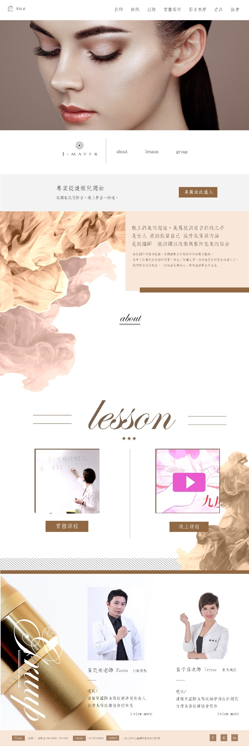

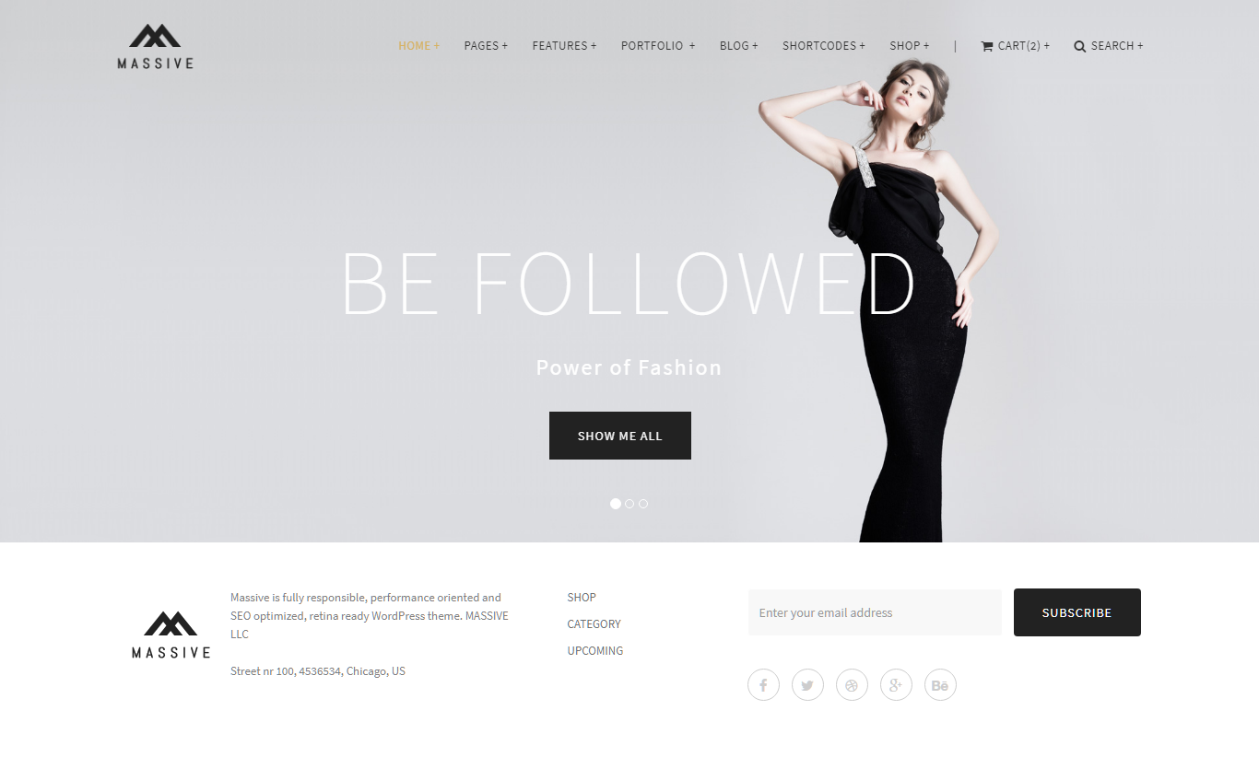
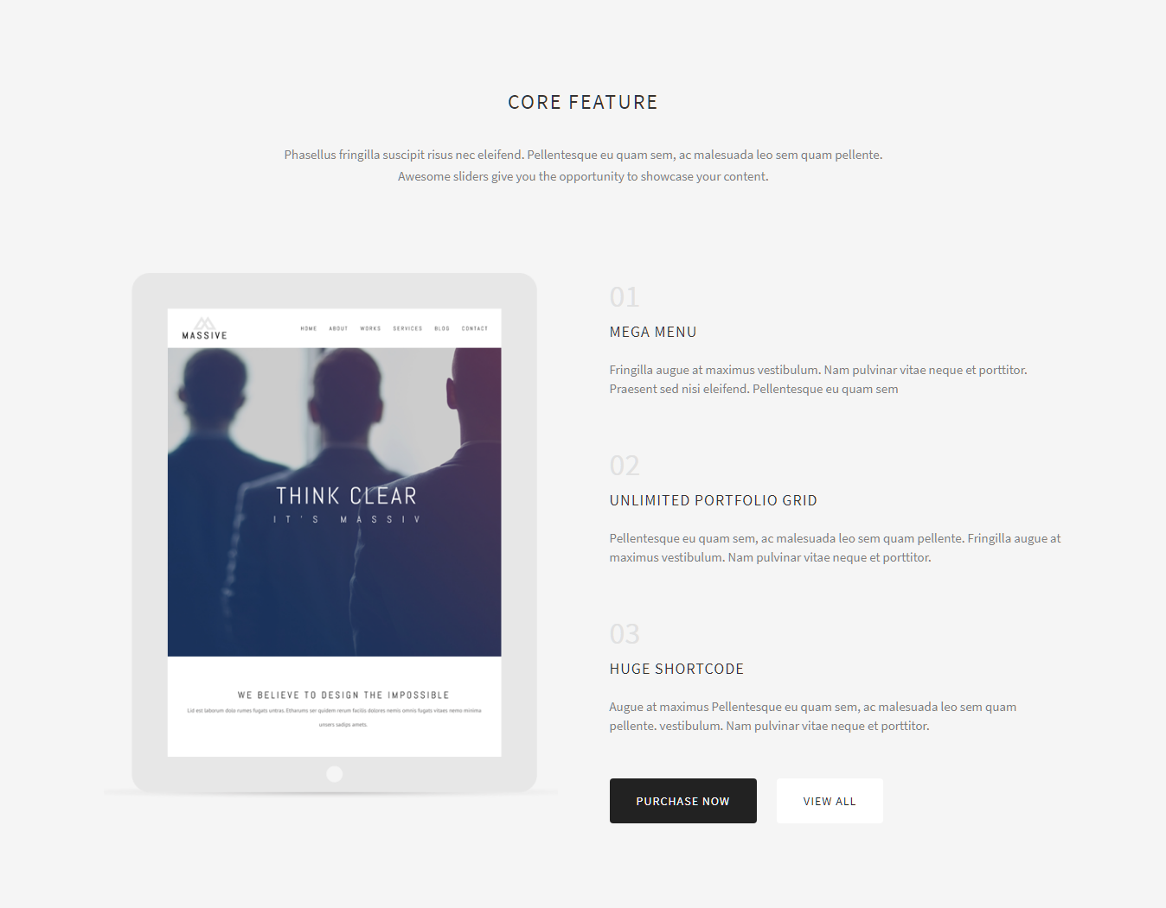
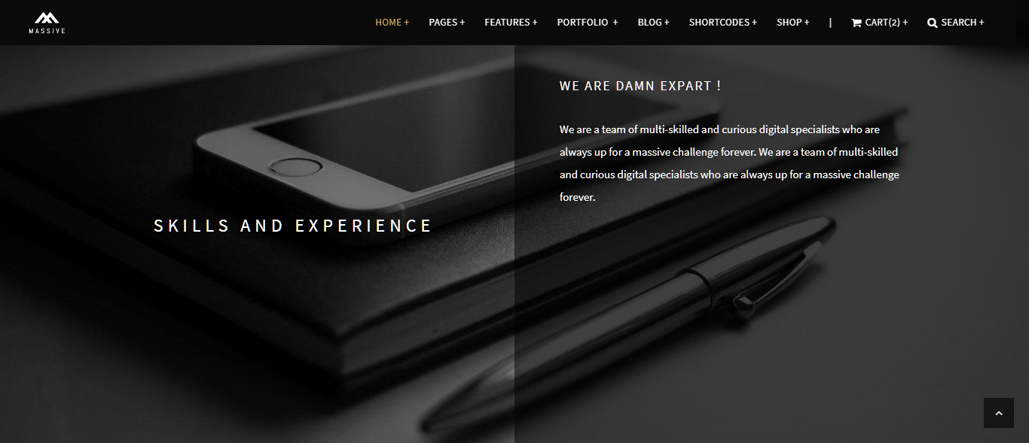
首頁
http://massive.markup.themebucket.net/mp-index-corporate-3.html
http://massive.markup.themebucket.net/mp-index-fashion-2.html
http://massive.markup.themebucket.net/mp-index-corporate-4.html
http://massive.markup.themebucket.net/mp-index-creative-1.html

Slide 3
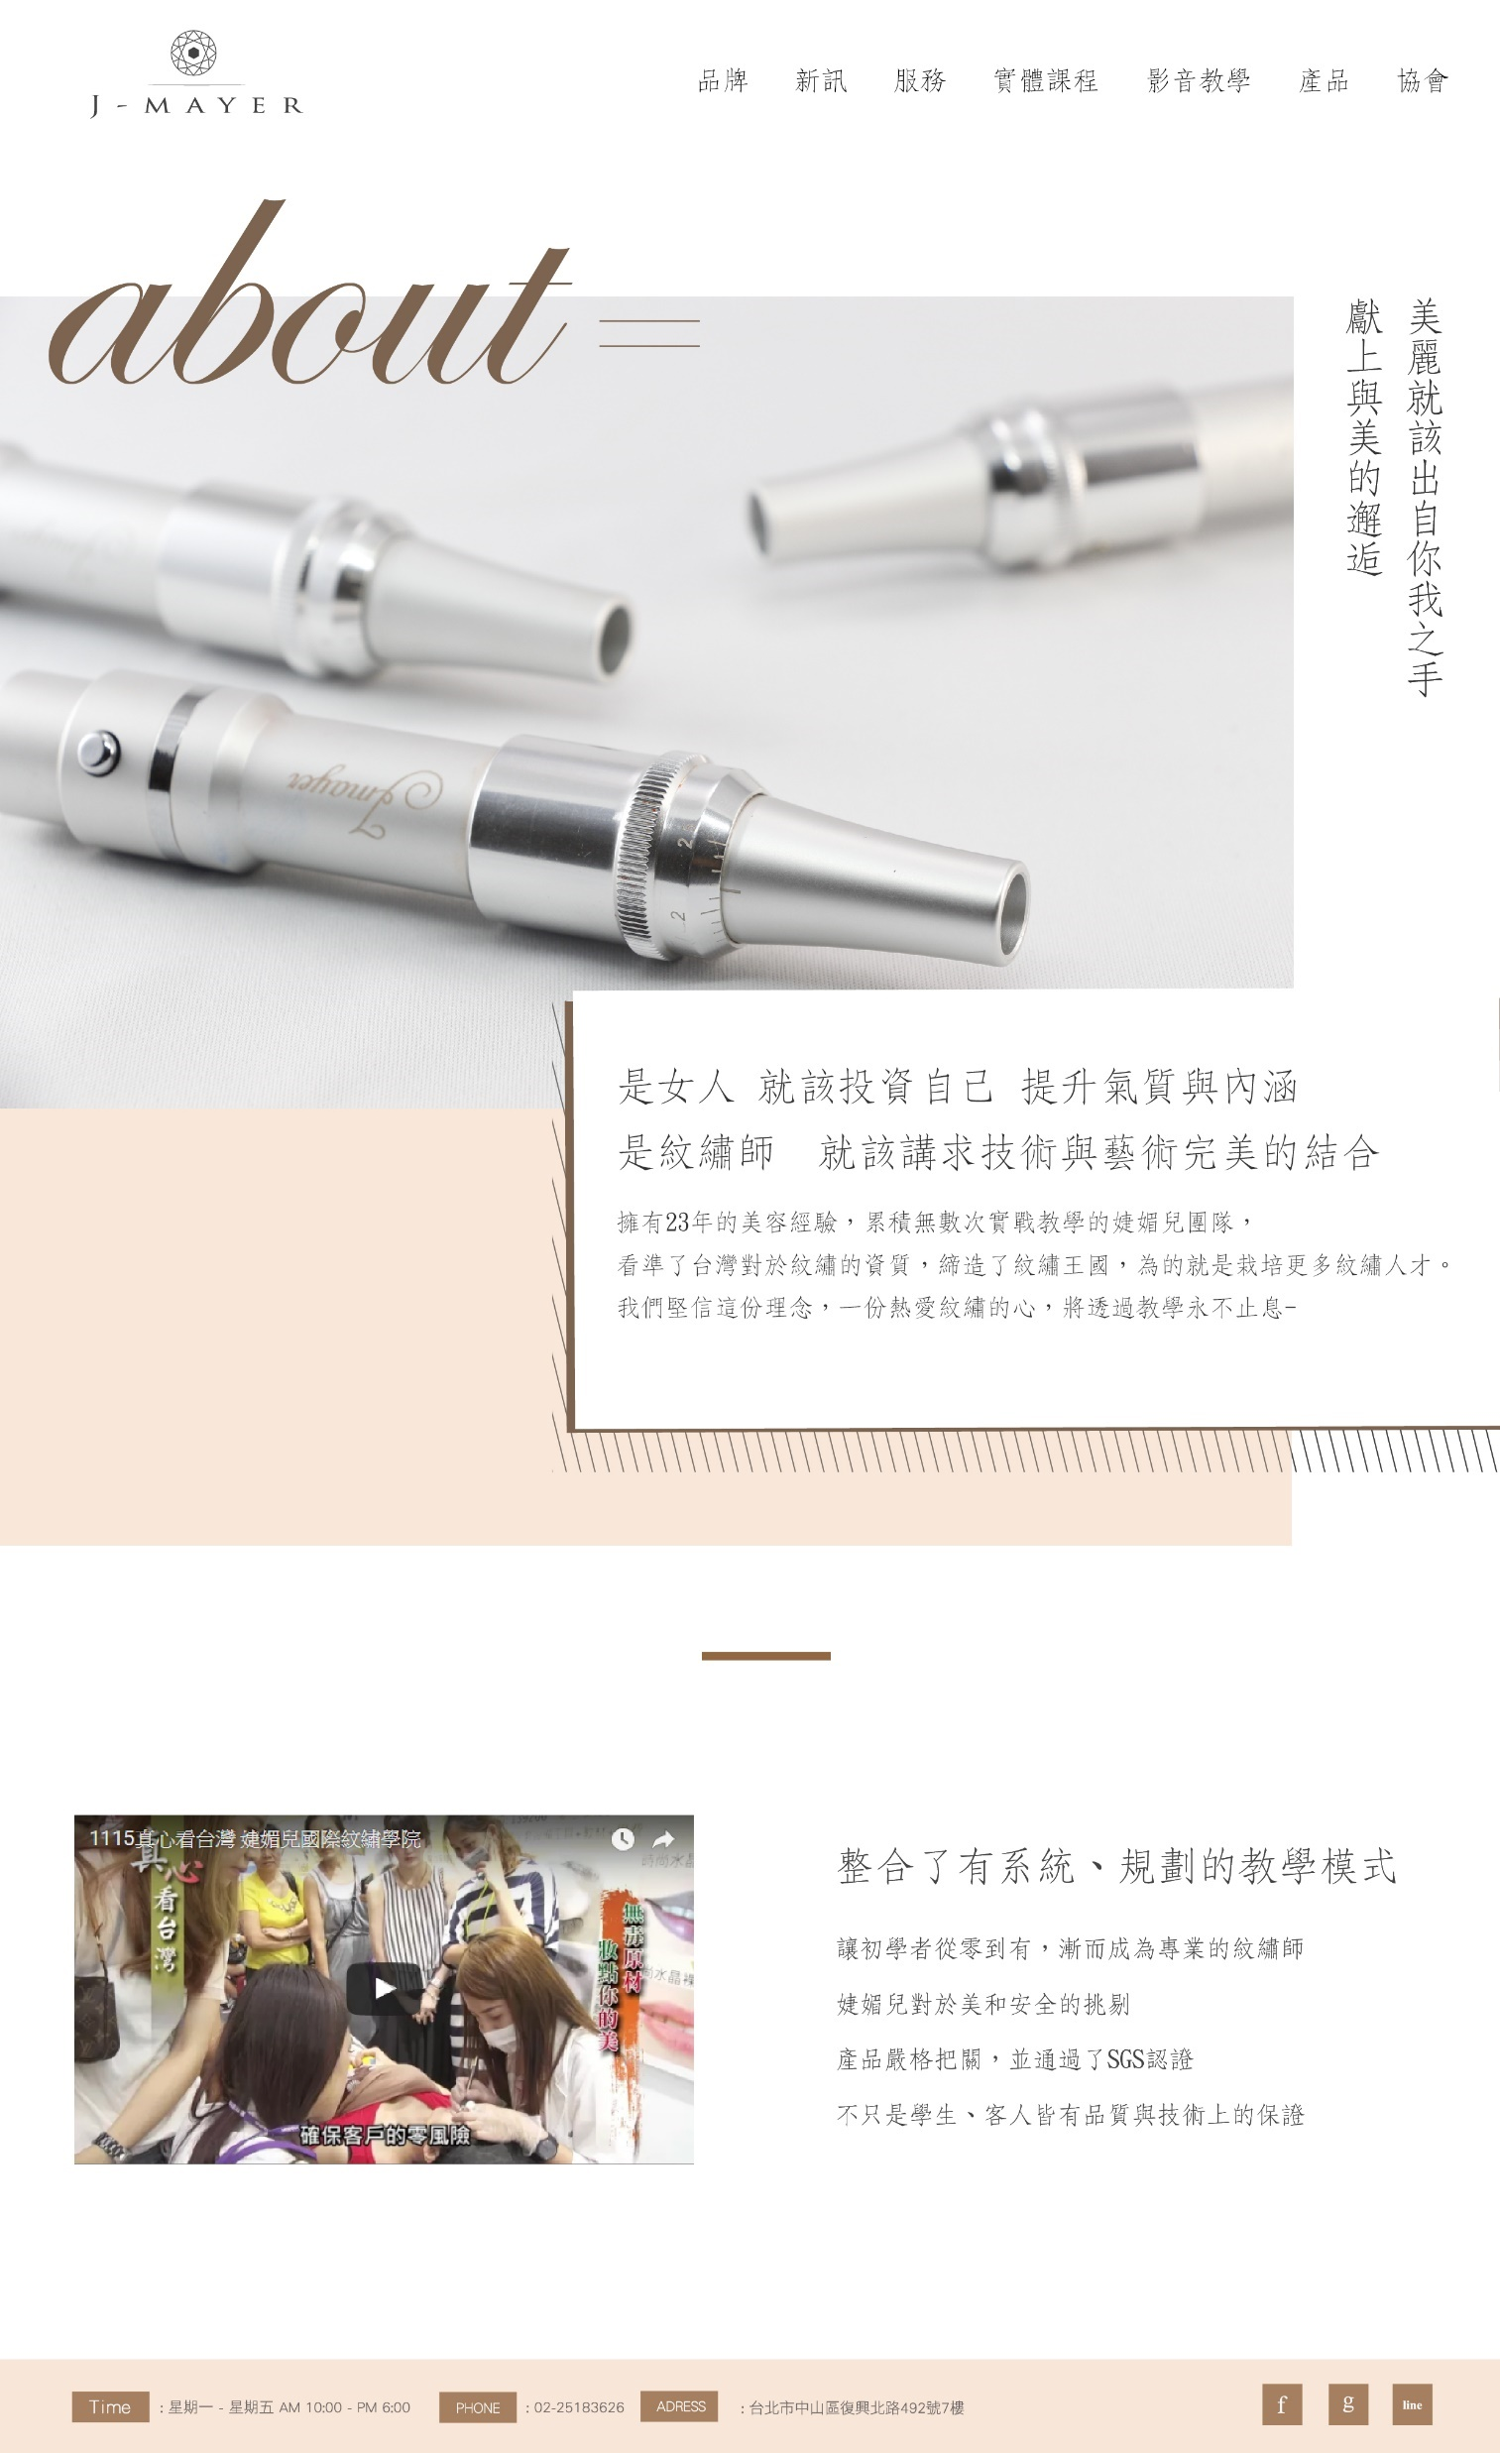

關於我們
http://massive.markup.themebucket.net/mp-index-real-state.html

Slide 4
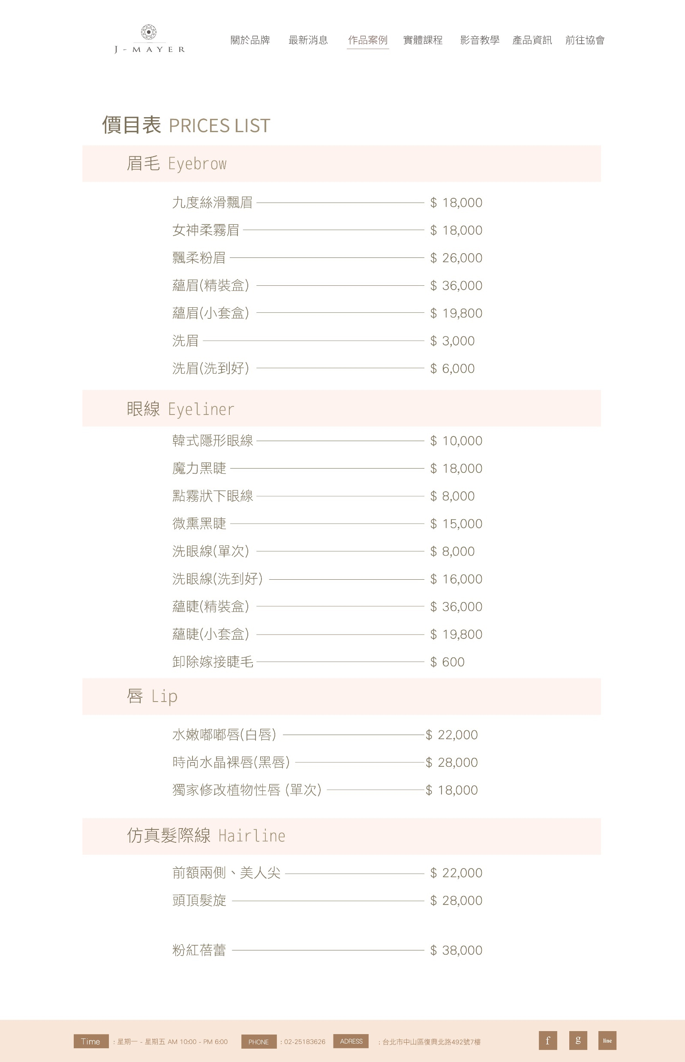
價目表

Slide 5
師資介紹

Slide 6
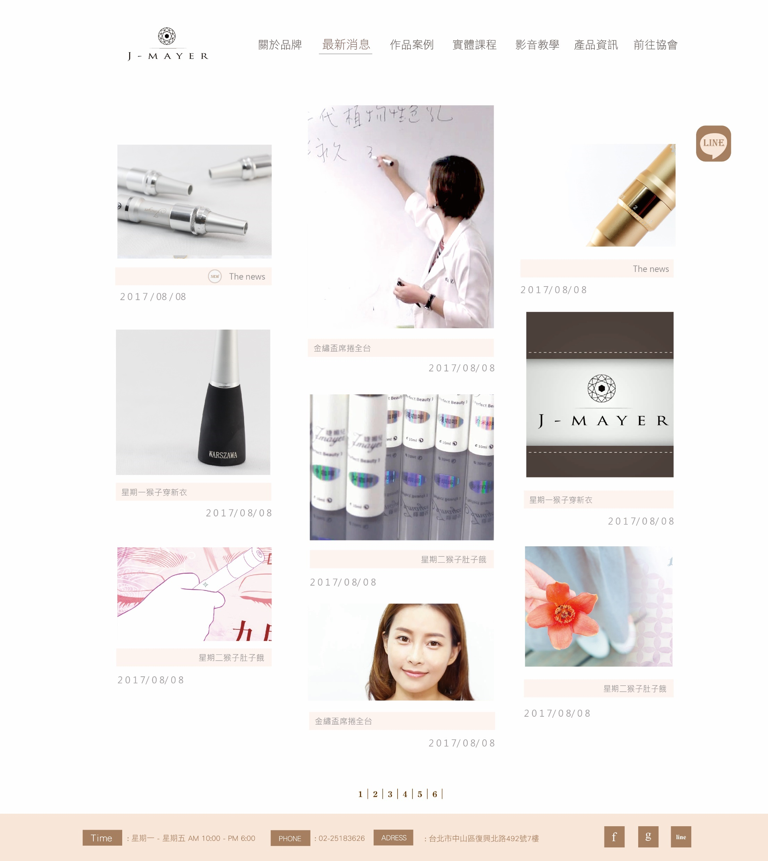
最新消息目錄頁
http://massive.markup.themebucket.net/blog-3-masonry.html

Slide 7
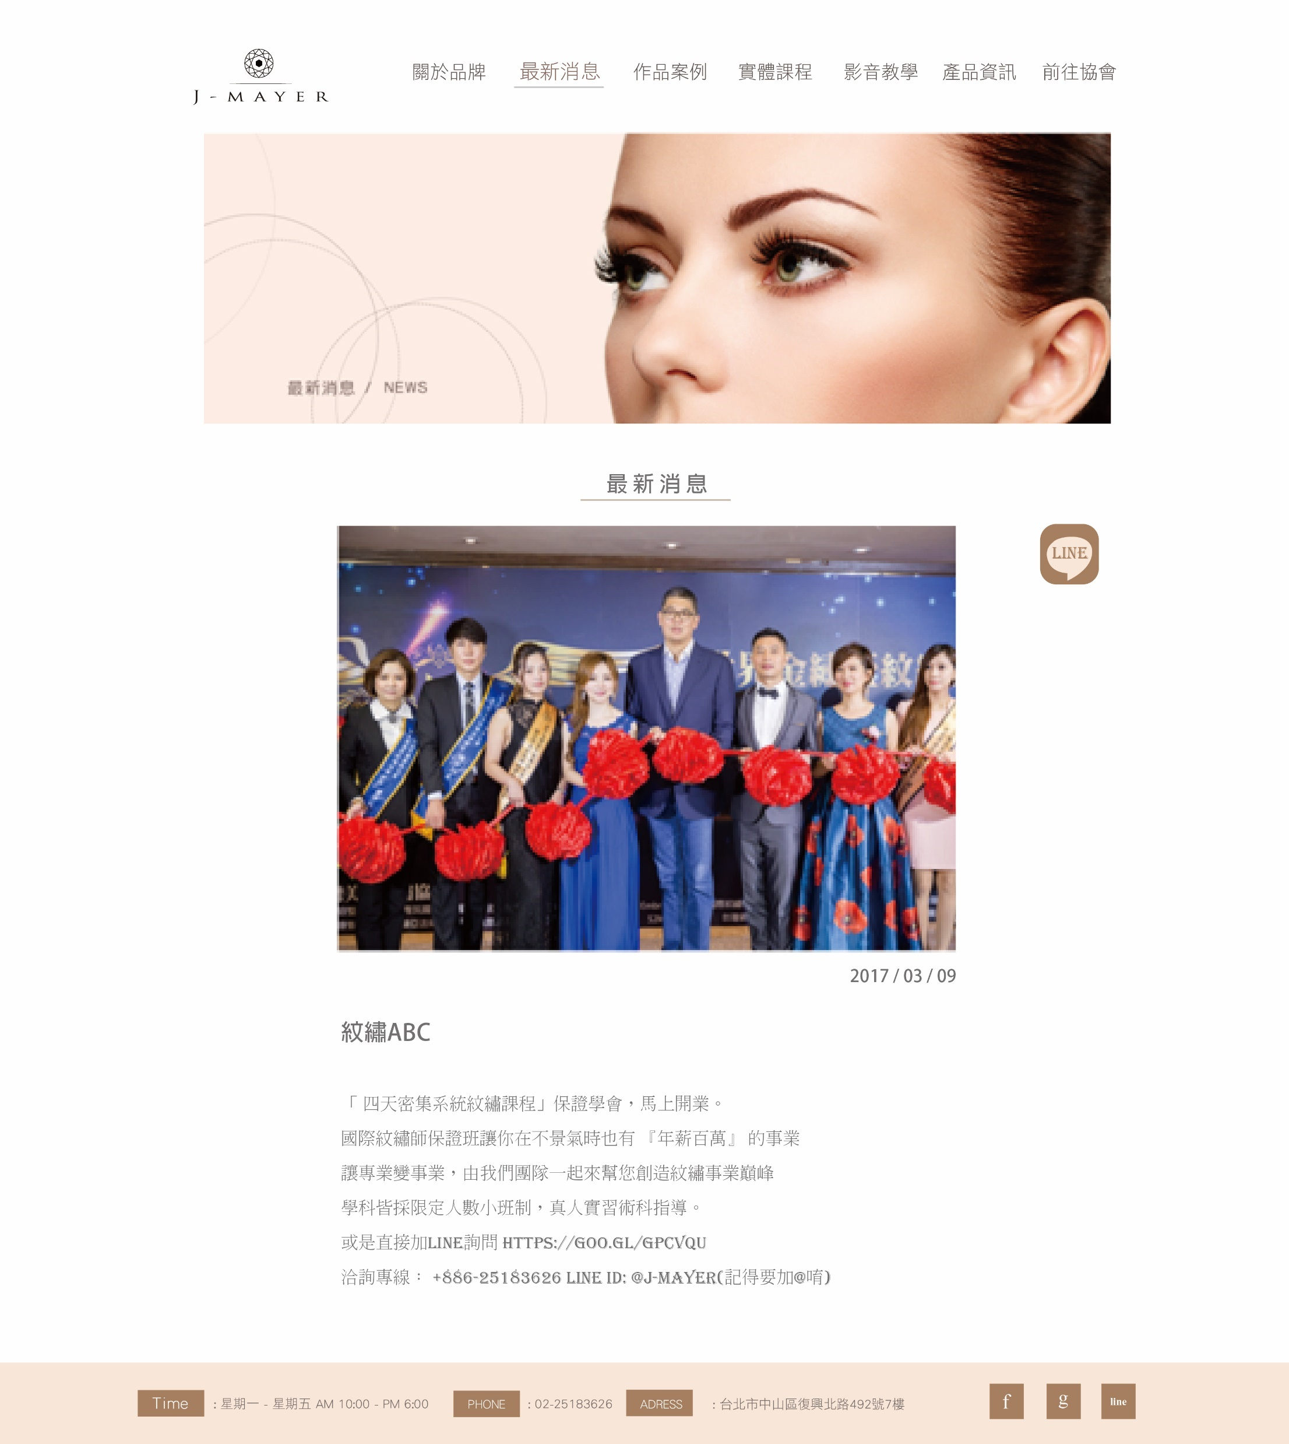
最新消息內頁
http://massive.markup.themebucket.net/blog-single-fullwidth.html

Slide 8
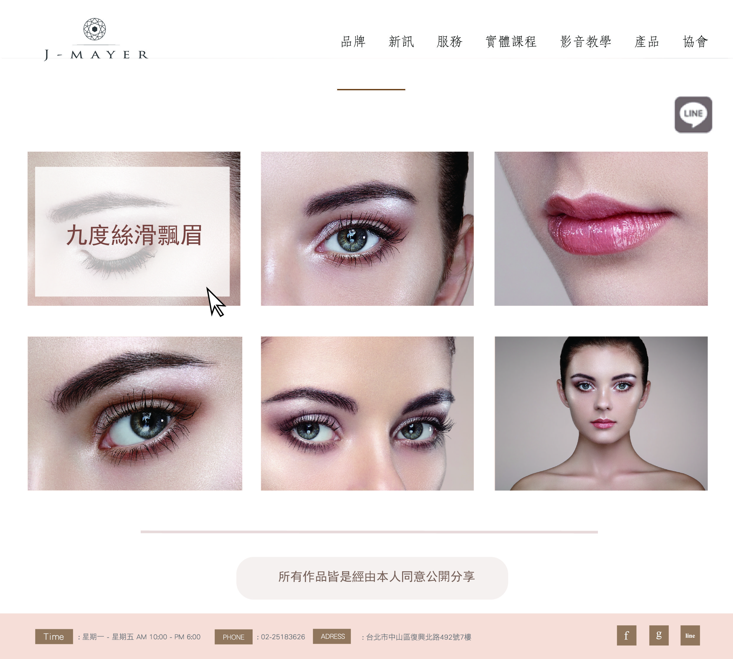
作品案例目錄頁
http://massive.markup.themebucket.net/portfolio-3-fullwidth.html

Slide 9
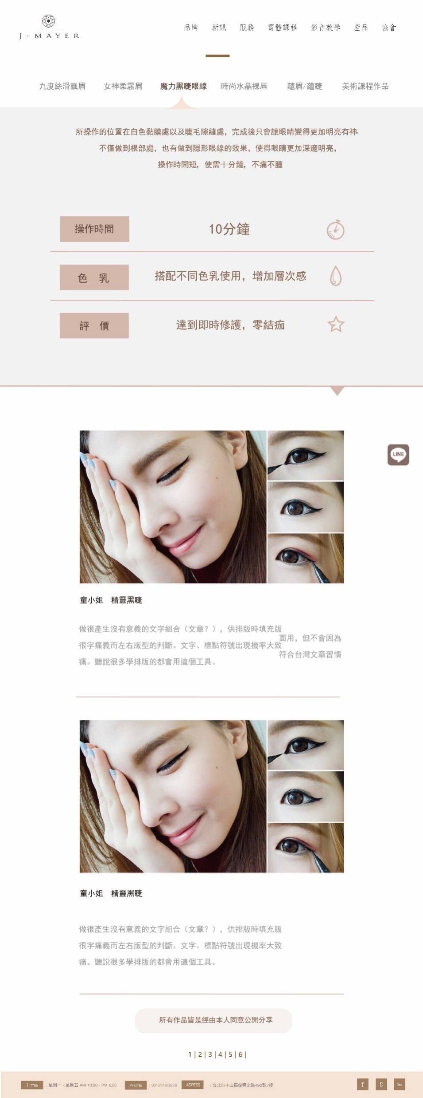
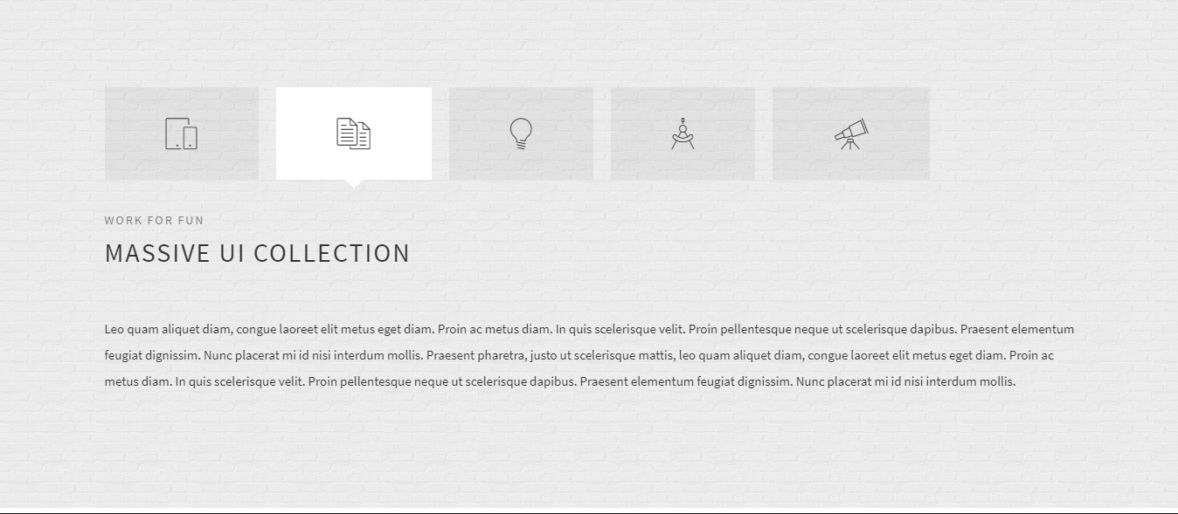
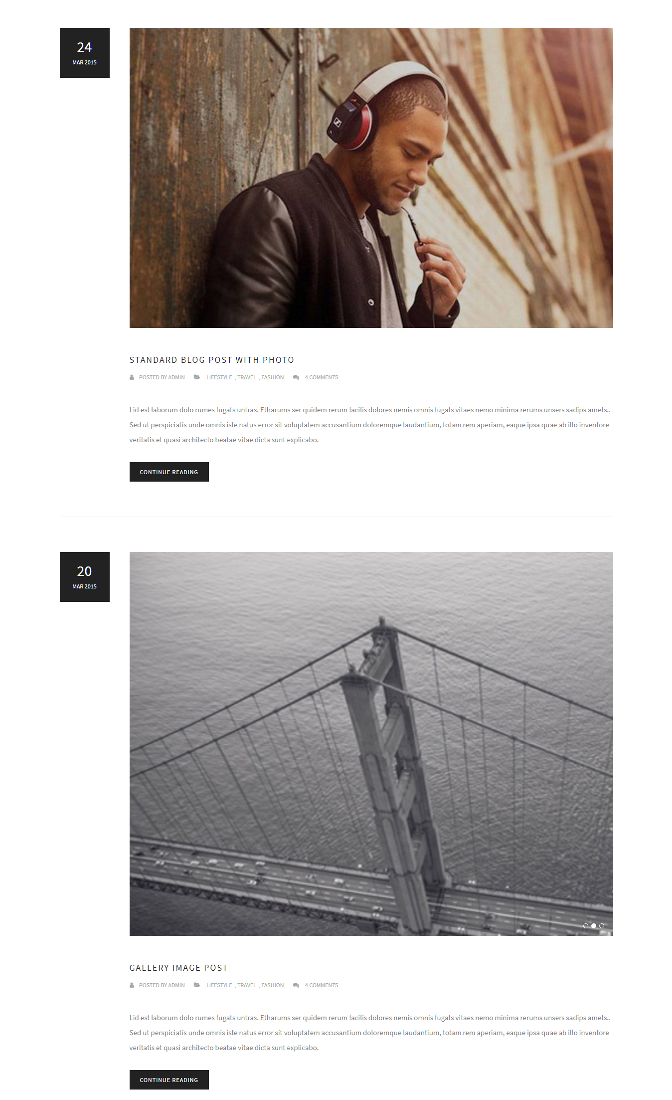
作品案例內頁
http://massive.markup.themebucket.net/mp-index-creative-4.html
http://massive.markup.themebucket.net/blog-fullwidth.html

Slide 10
課程長頁

Slide 11
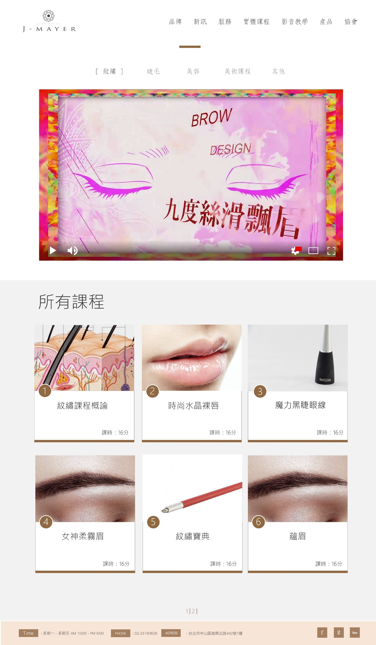
影音課程目錄頁
http://massive.markup.themebucket.net/portfolio-single-gallery.html
http://massive.markup.themebucket.net/portfolio-single-video.html

Slide 12
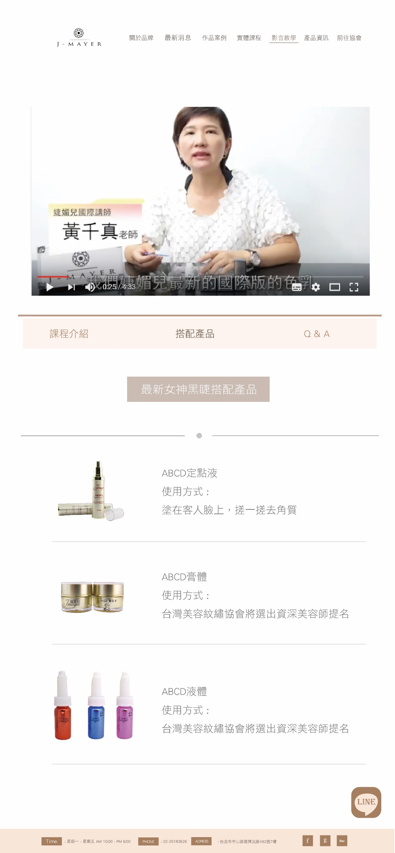
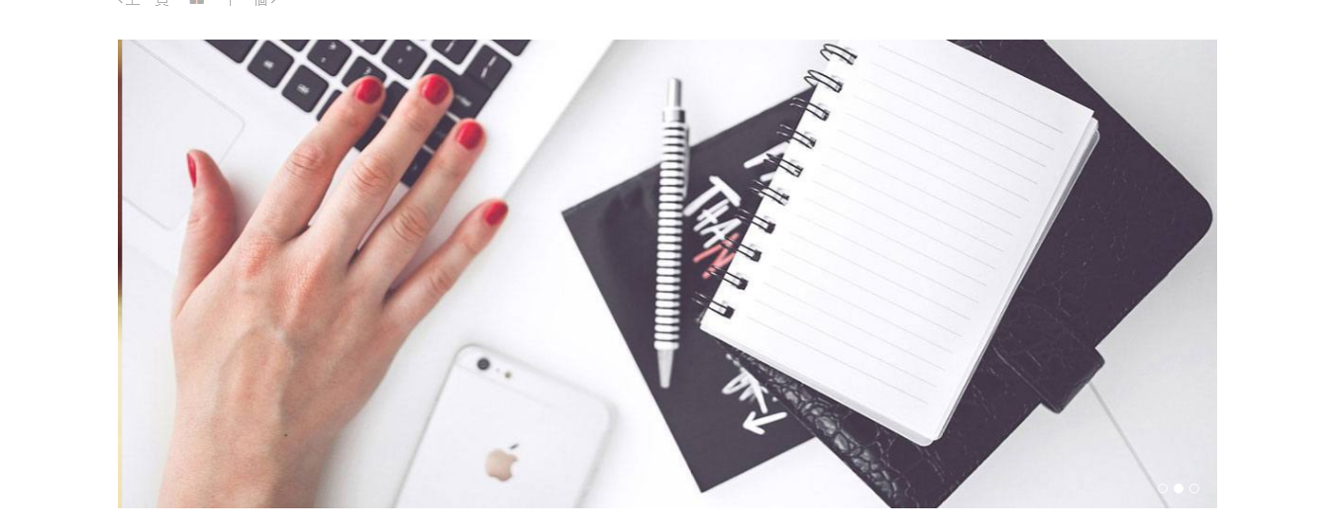
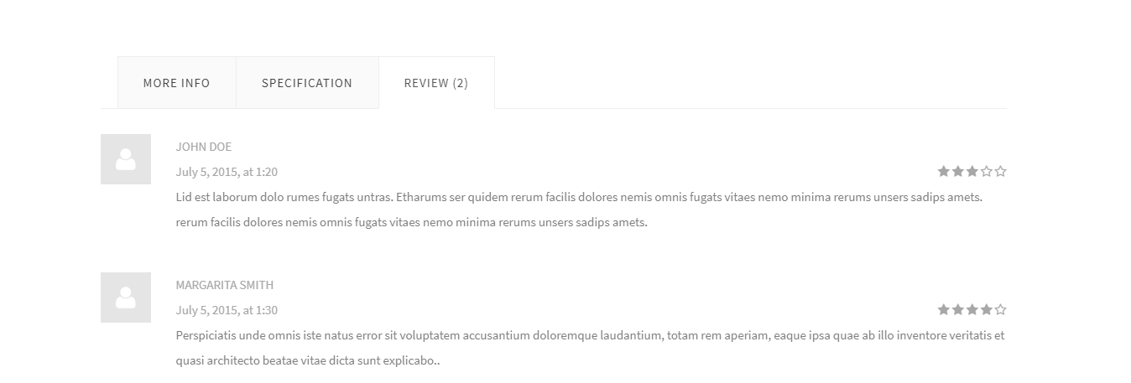
課程內頁
http://massive.markup.themebucket.net/portfolio-single-gallery.html#
http://massive.markup.themebucket.net/portfolio-single-video.html

Slide 13
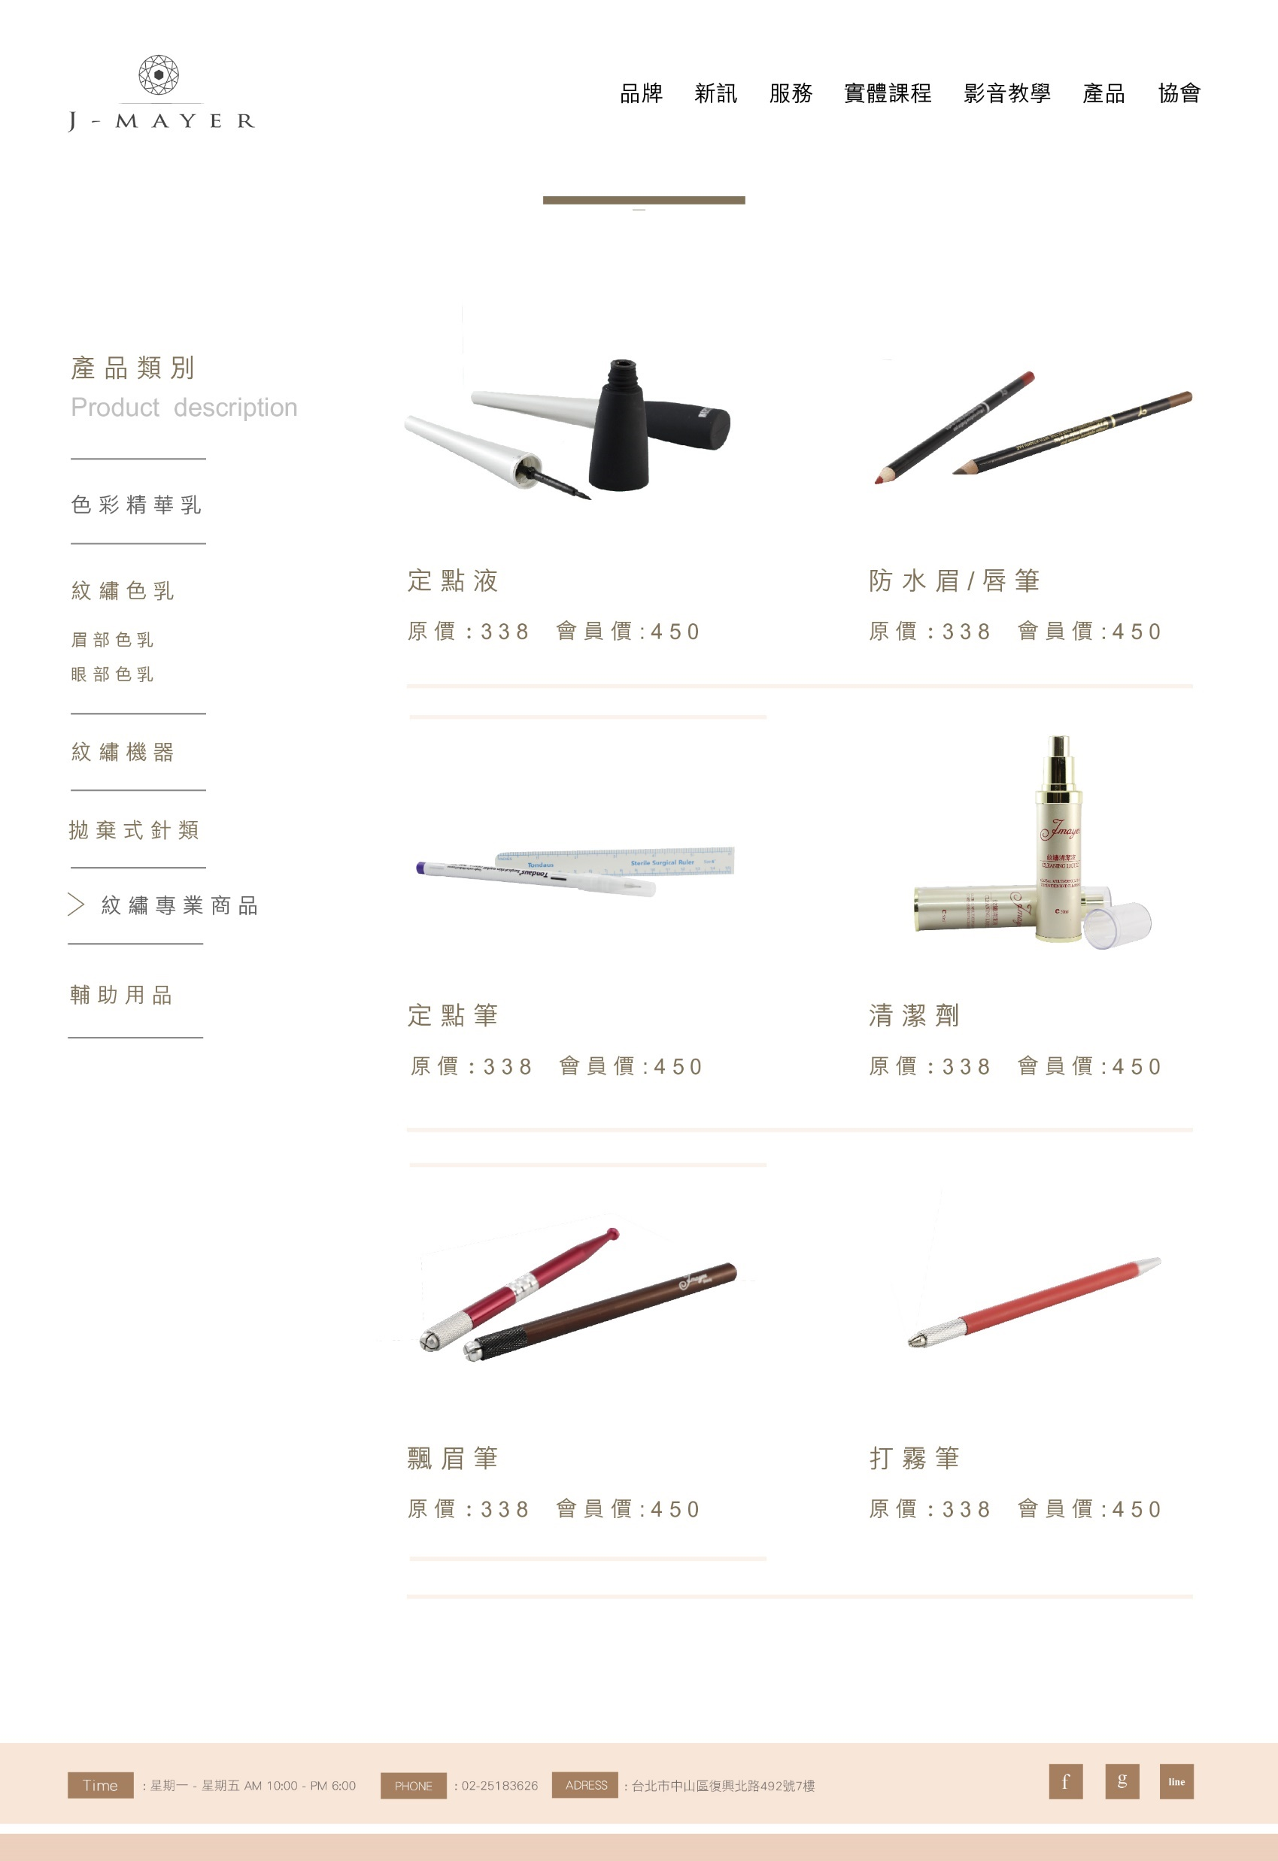
產品目錄頁
http://massive.markup.themebucket.net/shop-2.html

Slide 14
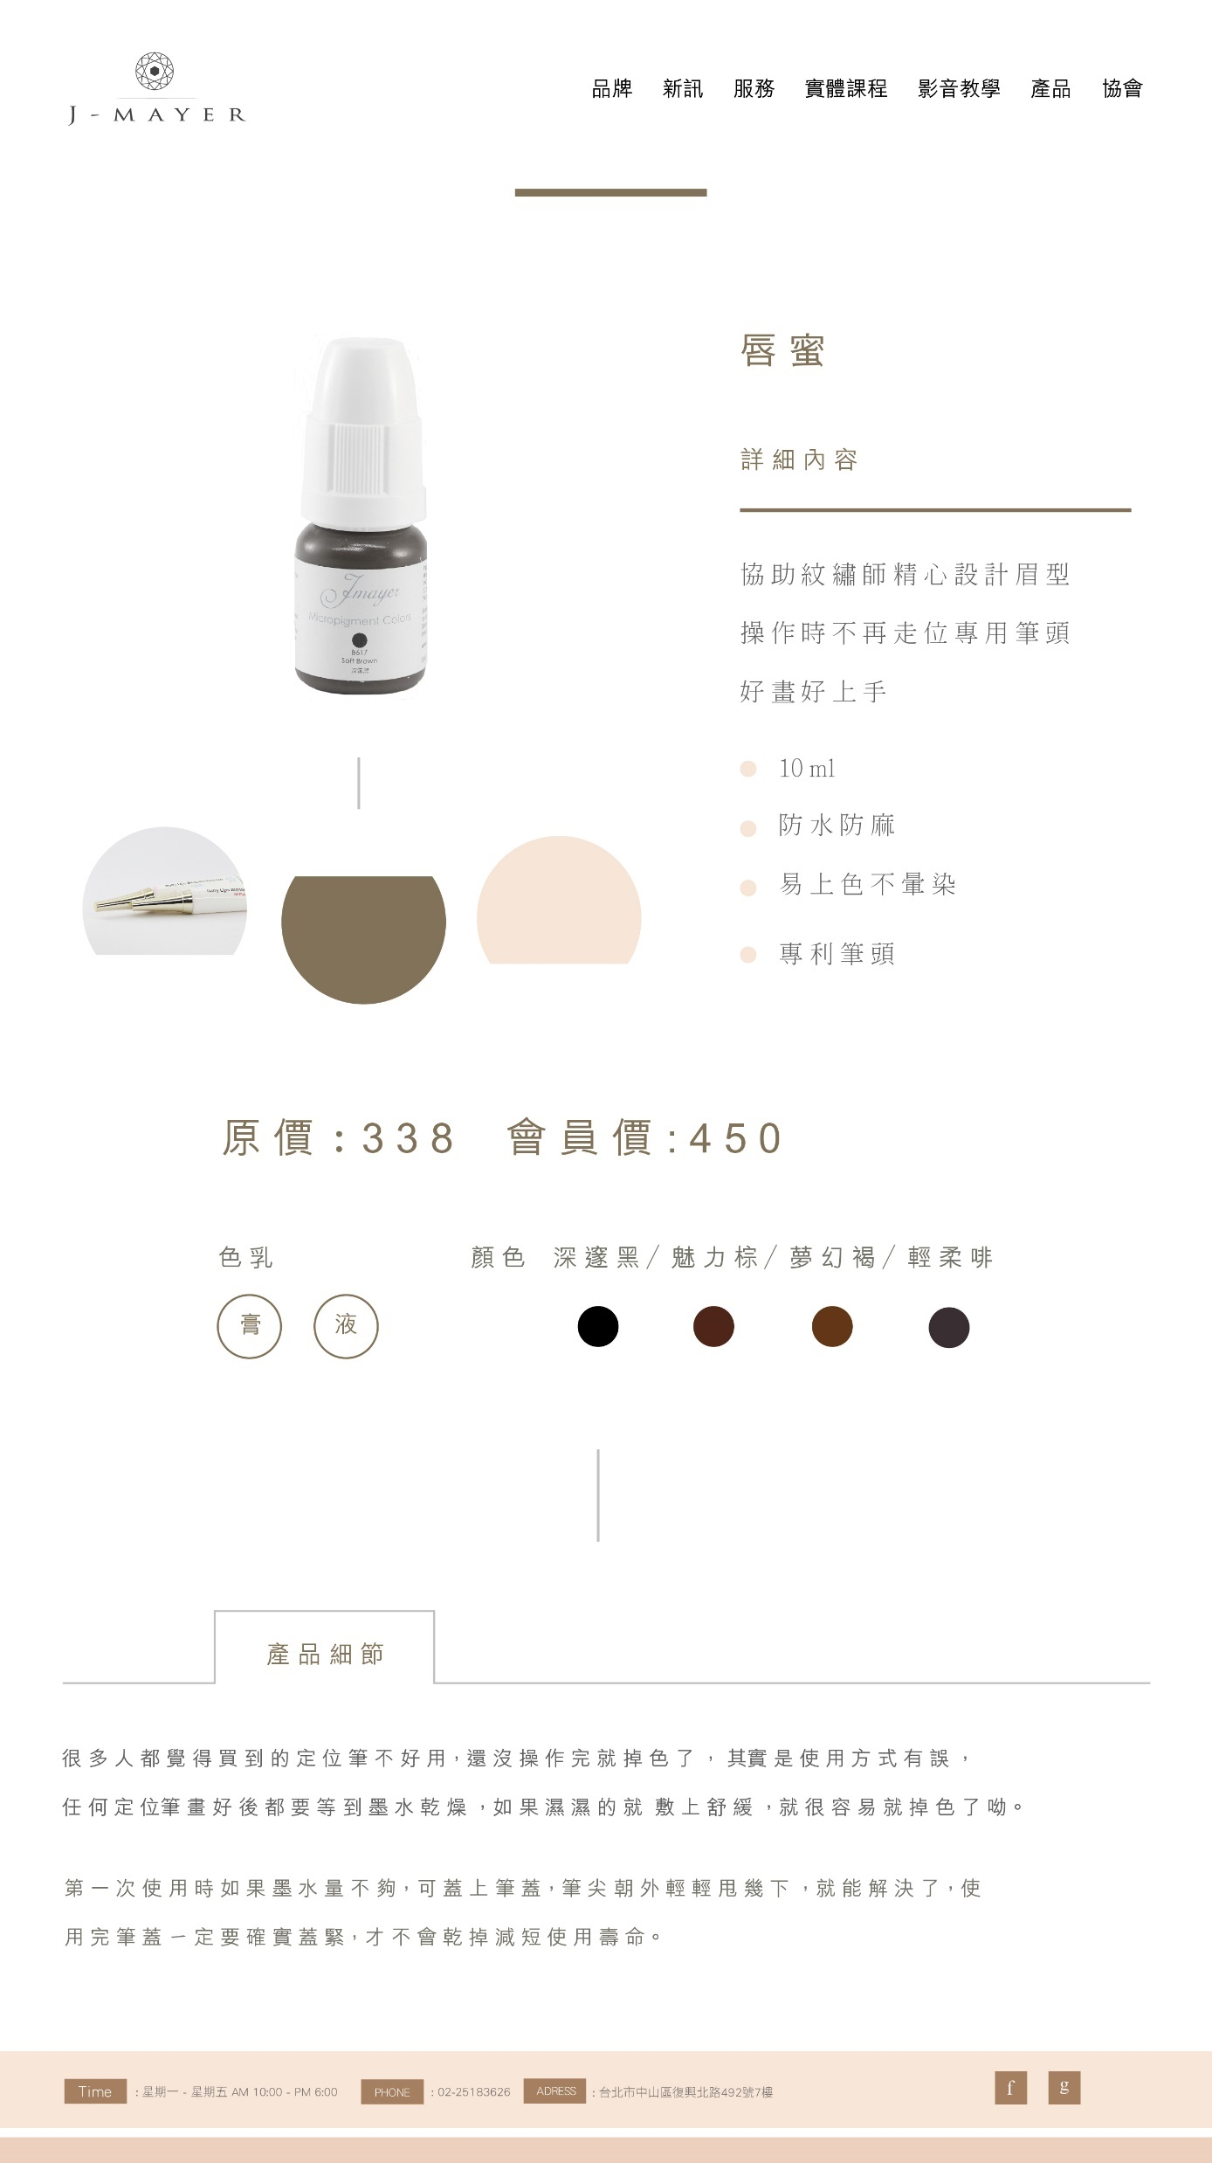
產品內頁
http://massive.markup.themebucket.net/shop-single.html

